Slide 1
Physical Design Week 4
RAID, Indexes, B-Trees, Triggers
Dr. Pierpaolo Dondio,
DT228/4

Slide 2
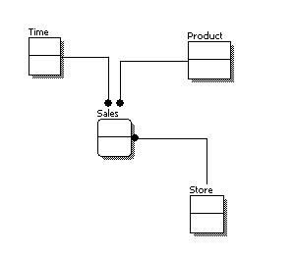
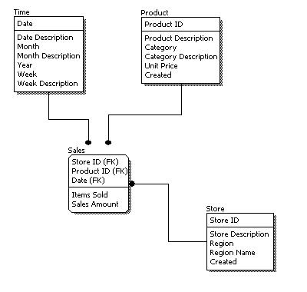
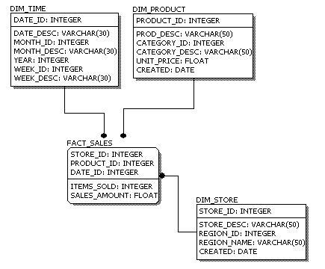
Physical database design
Process of producing a description of the implementation of the database on secondary storage. It describes the relations, file organizations, and indexes used to achieve efficient access to the data, and any associated integrity constraints and security measures.
Conceptual (ER)
Logical (Relational)
Physical

Slide 3
Indexes

Slide 4
Type of File
Database tables are saved on a collections of files
Type of file:
Unordered
Ordered
Hashed

Slide 5
Type of File: Unordered
Also called a heap or a pile file.
New records are inserted at the end of the file.
A linear search through the file records is necessary to search for a record.
This requires reading and searching half the file blocks on the average, and is hence quite expensive.
Record insertion is quite efficient.
Reading the records in order of a particular field requires sorting the file records.

Slide 6
Ordered Files
Also called a sequential file.
File records are kept sorted by the values of an ordering field.
Insertion is expensive: records must be inserted in the correct order.
It is common to keep a separate unordered overflow (or transaction) file for new records to improve insertion efficiency; this is periodically merged with the main ordered file.
A binary search can be used to search for a record on its ordering field value.
This requires reading and searching log₂ of the file blocks on the average, an improvement over linear search.
Reading the records in order of the ordering field is quite efficient.

Slide 7
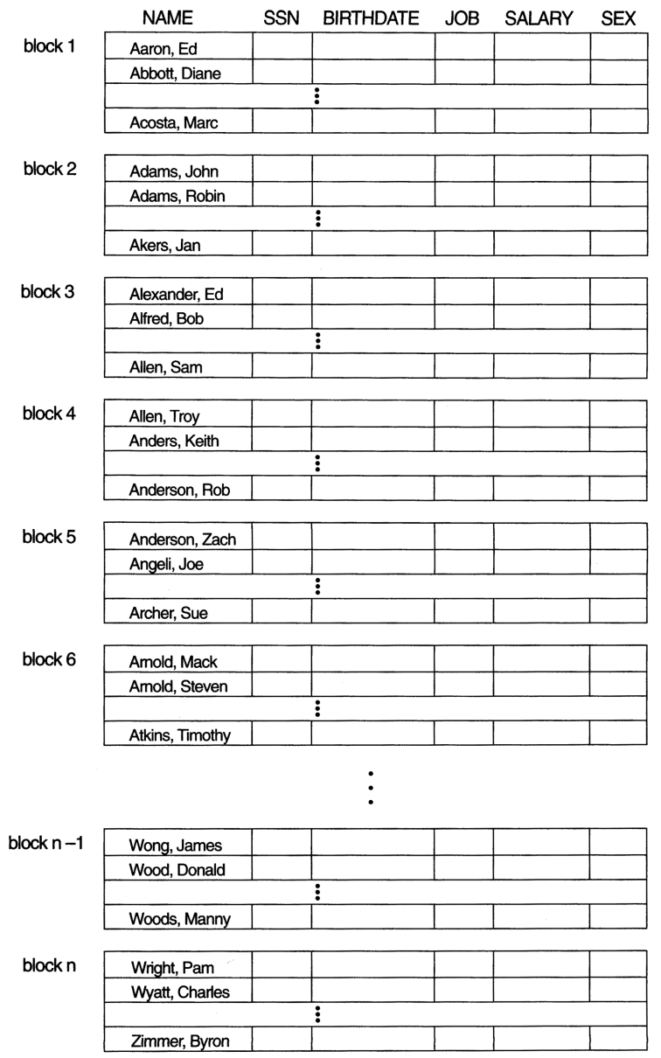
Ordered Files

Slide 8
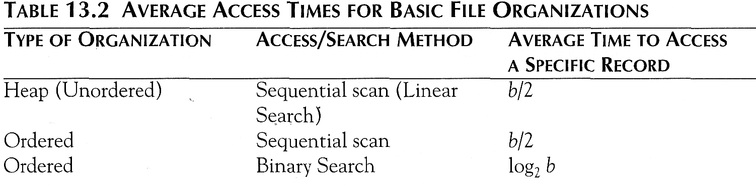
Average Access Times
The following table shows the average access time to access a specific record for a given type of file

Slide 9
Hashed Files
The file blocks are divided into M equal-sized buckets, numbered bucket₀, bucket₁, ..., bucket_{M-1}.
Typically, a bucket corresponds to one (or a fixed number of) disk block.
One of the file fields is designated to be the hash key of the file.
The record with hash key value K is stored in bucket i, where i=h(K), and h is the hashing function.
Search is very efficient on the hash key.
Collisions occur when a new record hashes to a bucket that is already full.
An overflow file is kept for storing such records.
Overflow records that hash to each bucket can be linked together.

Slide 10
Hashed Files (contd.)
There are numerous methods for collision resolution, including the following:
Open addressing: Proceeding from the occupied position specified by the hash address, the program checks the subsequent positions in order until an unused (empty) position is found.
Chaining: For this method, various overflow locations are kept, usually by extending the array with a number of overflow positions. In addition, a pointer field is added to each record location. A collision is resolved by placing the new record in an unused overflow location and setting the pointer of the occupied hash address location to the address of that overflow location.
Multiple hashing: The program applies a second hash function if the first results in a collision. If another collision results, the program uses open addressing or applies a third hash function and then uses open addressing if necessary.

Slide 11
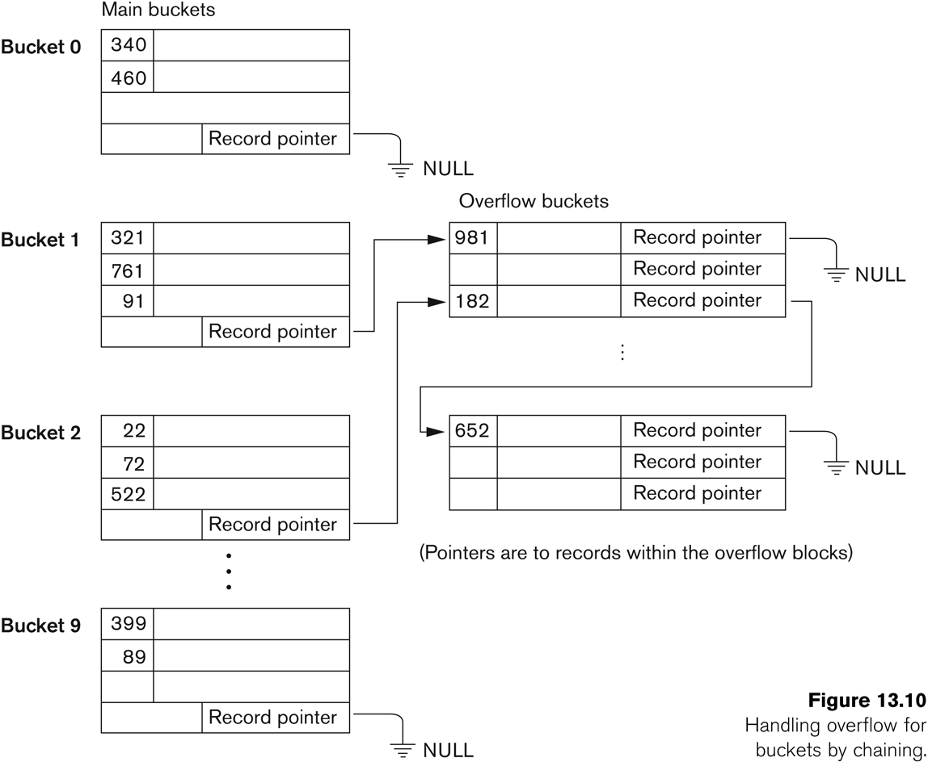
Hashed Files - Chaining

Slide 12
Hashed Files (contd.)
To reduce overflow records, a hash file is typically kept 70-80% full.
The hash function h should distribute the records uniformly among the buckets
Otherwise, search time will be increased because many overflow records will exist.
Main disadvantages of static external hashing:
Fixed number of buckets M is a problem if the number of records in the file grows or shrinks.
Ordered access on the hash key is quite inefficient (requires sorting the records).

Slide 13
Dynamic And Extendible Hashed Files
Dynamic and Extendible Hashing Techniques
Hashing techniques are adapted to allow the dynamic growth and shrinking of the number of file records.
These techniques include the following: dynamic hashing, extendible hashing, and linear hashing.
Both dynamic and extendible hashing use the binary representation of the hash value h(K) in order to access a directory.
In dynamic hashing the directory is a binary tree.
In extendible hashing the directory is an array of size 2^{d} where d is called the global depth.

Slide 14
Dynamic And Extendible Hashing (contd.)
The directories can be stored on disk, and they expand or shrink dynamically.
Directory entries point to the disk blocks that contain the stored records.
An insertion in a disk block that is full causes the block to split into two blocks and the records are redistributed among the two blocks.
The directory is updated appropriately.
Dynamic and extendible hashing do not require an overflow area.

Slide 15
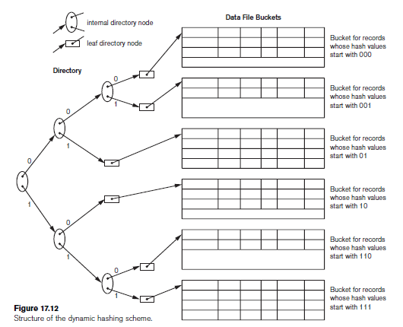
Dynamic Hashing

Slide 16
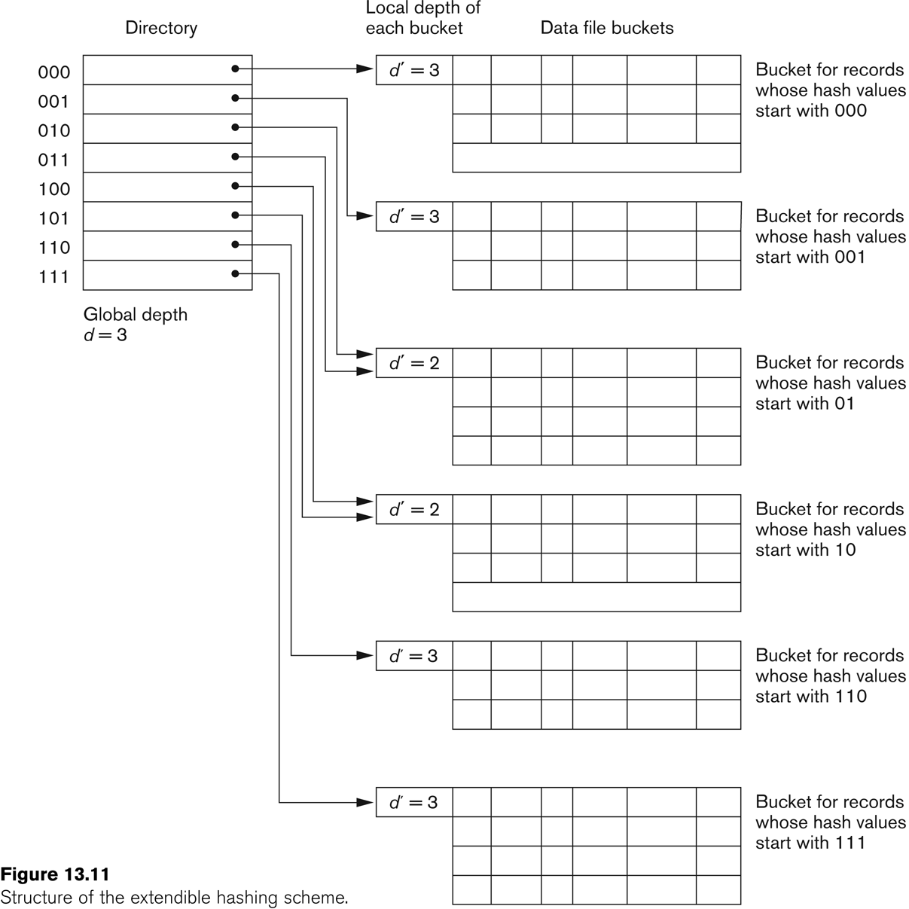
Extendible Hashing

Slide 17
Index Structures for Databases

Slide 18
Indexes
Indexes are additional auxiliary access structures with typically provide either faster access to data or secondary access paths without effecting the physical storage of the data.
They are based on indexing field(s) that are used to construct the index.
Indexes can be sparse or dense. A dense index has an entry for each record.

Slide 19
Types of Indexes
Single-Level Indexes
Primary (Clustered or not)
Secondary
Bitmap
Multi-Level Indexes
Binary Trees
B-Trees
Notes:
ISAM Indexed Sequential Access Method

Slide 20
Single Level Indexes
Single Level = there is only 1 level of indirection. The entries in the index are pointing to the data in the table
Multiple-Index = entries in the index might point to other entries in the index , that eventually point to the data
A Primary Index is specified on the ordering key field where each tuple has a unique value.
A Secondary Index is specified on a NON-ORDERING Field of the file.

Slide 21
Primary Indexes
A Primary Index is constructed of two parts: The first field is the same data type of the primary key of a file block of the data file and the second field is file block pointer.
If the primary index is clustered, the file is physically sorted using the indexing field. If this is the case:
The Anchor Record or Block anchor is the first record in a file block. This is where the value for the first field of the primary index come from along with the respective address of that block.
Notes:
Mention that this is a sparse index Vs a dense index which has an entry for every key search value.

Slide 22
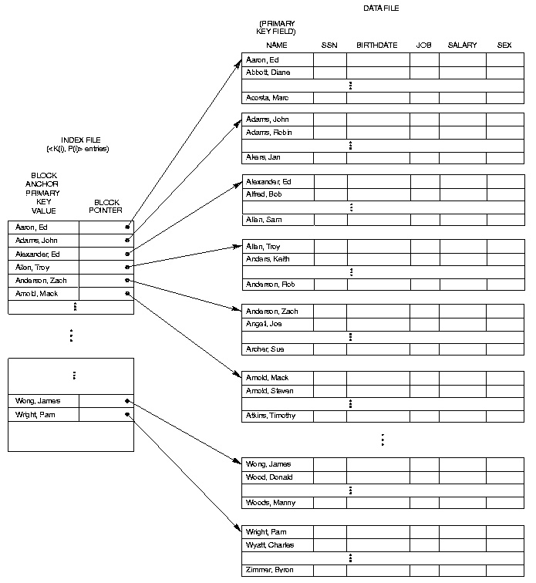
Primary Indexes (clustered)

Slide 23
Primary Indexes (clustered)
The primary index file is usually smaller than the data file it’s indexing because
There are usually fewer index entries than records in the data file (because a block holds more than one record)
The individual index records are smaller than data file records
Binary search on index file is faster than binary search on the database
But slow for insertion and deletion
records have to be kept in order in the data file
AND index file has to be kept in order too

Slide 24
Note on Primary Index (clustered)
We have shown a primary sparse index, where the “big” file (=table) is physically sorted by the key and the index structure indexes each block. This is usually called a clustered index, since each entry in the index points to a “cluster” or values
Some DBs (latest Oracle versions) implement primary index like secondary index.
The table is left unordered like a heap
The index structure has an entry for each record (not each block) and it is a dense index

Slide 25
Secondary Indexes
An index file that uses a non primary field as an index e.g. Job field in the employee table
They improve the performance of queries that use attributes other than the primary key
You can use a separate index for every attribute you wish to use in the WHERE clause of your select query
But there is the overhead of maintaining a large number of these indexes

Slide 26
Secondary Indexes
A Secondary Index is an ordered file with two fields. The first is of the same data type as some nonordering field and the second is either a block or a record pointer.
If the entries in this nonordering field must be unique this field is sometime referred to as a Secondary Key. This results in a dense index.
For a secondary index, an external index file has a list of pointers to the various values of the indexed column (i.e. It’s a logical index, not physical) so you can have many secondary indexes
What would a secondary index to a telephone directory look like? E.g. Road Name?
WHY would you use a secondary index?

Slide 27
Primary Indexes (not clustered)
A Primary Index can also be not clustered. In this case, the file (table) is not physically sorted by the index key.
For each entry in the table, there is an entry in the index, so a primary index not clustered is a dense index.

Slide 28
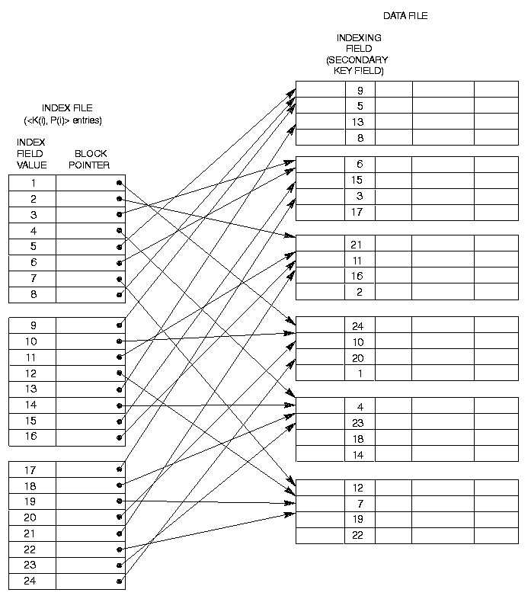
Primary Indexes (not clustered)

Slide 29
Secondary Index on Non-Key Field
A secondary index is an index defined on a non-key field. It can be implemented as a primary index (not clustered) but since there is no guarantee that the value will be unique the previous index method will not work in all the case.
Option 1: Include index entries for each record. This results in multiple entries of the same value.
Option 2: Use variable length records with a pointer to each block/record with that value.
Option 3: Have the pointer; point to a block or chain of blocks that contain pointers to all the blocks/records that contain the field value. Example of multi-level index

Slide 30
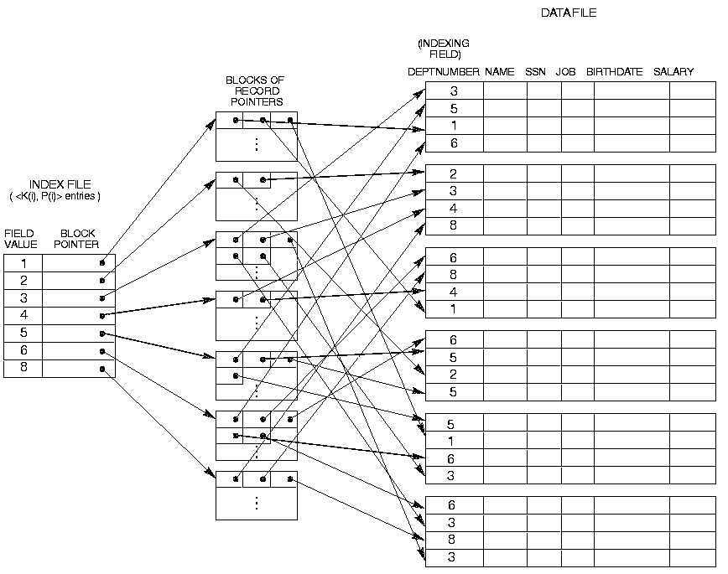
Secondary Index on Non-Key Field

Slide 31
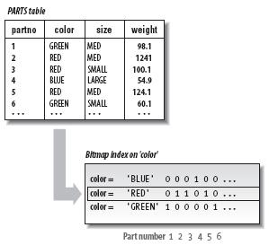
Bitmap Index
An index implemented as a map of bits
Each unique entry in the index is a string of bits
Usually used on fields that are not (or rarely) modified
Fields with low cardinality
Used in read-only environment like data warehouses
Typical example: day of the week, gender,…
How many bytes is a bitmap index on:
Day of the week for 10 millions records
Gender for 1 billion records

Slide 32
Multilevel Indexes
A Multilevel Index is where you construct an Second- Level index on a First-Level Index. Continue this process until the entire index can be contained in a Single File Block.
This allows much faster access than binary search because at each level the size of the index is reduced by the fan out factor. Rather just by 2 as in binary search.

Slide 33
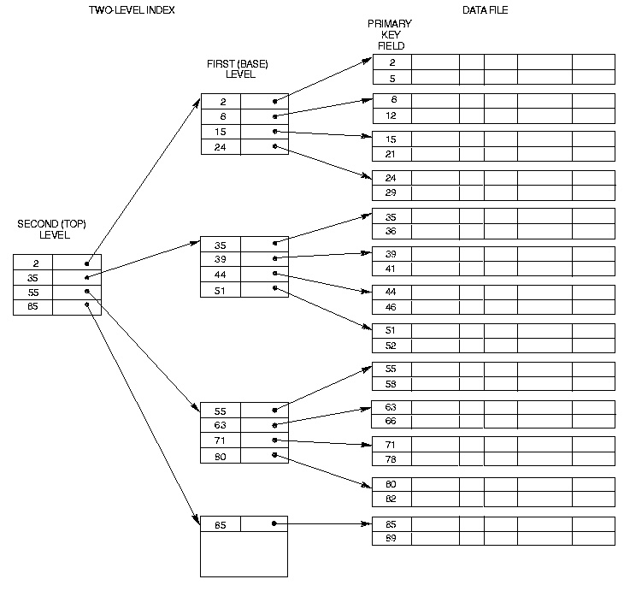
Multilevel Indexes

Slide 34
Multilevel index
In databases, multi-level indexes are implemented using a tree structure
A tree is a data structure with specific rules, which ones?

Slide 35
Multilevel Indexes Using Search Trees, B-Trees & B+ Trees
A Search Tree of order p differs from a Multilevel Index in that each node contains a most p - 1 search values and p pointers.
There is no requirement that the Search Tree be Balanced.

Slide 36
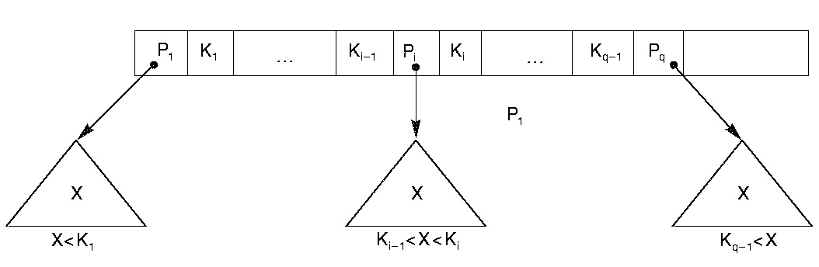

Slide 37
B-Trees
B-Trees address the problems with Search Trees in that they have the additional constraint that they be balanced and they contain pointers to data records.
Each B-Trees is made up of at most P tree pointers and P-1 field values K and data pointers Pr.

Slide 38
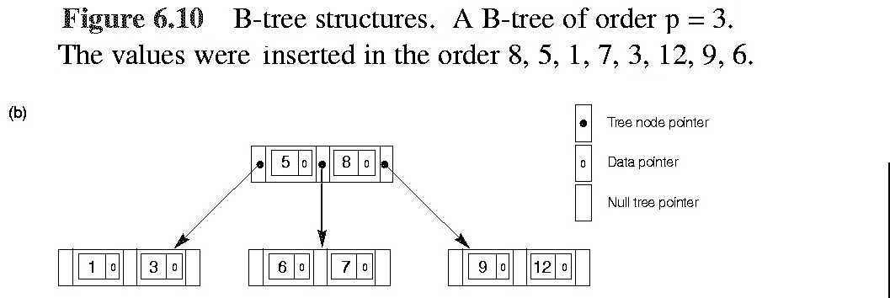

Slide 39
TRIGGERS

Slide 40
What is a trigger?
A block of code that is attached to an event. When that event occurs the trigger code is fired.
A stored block with [Declare], Begin, End.
Associated with a database table or action
Fires automatically when certain DML action is carried out on the table
Before or after an event
Change may be INSERT, DELETE, UPDATE
Do we want to perform on multiple rows?
If not, then Statement level trigger fires once only
If so, then Row level trigger fires for each affected row

Slide 41
Trigger Uses
Auditing
Write information about (sensitive) data modifications to an audit table
May include old and new values, user, timestamp
E.g. new and old salary
Data Integrity
Implement checks on data against business rules
Can compare with live database values
NEW and OLD values can be compared
E.g. prices must not go down

Slide 42
Trigger Uses
Referential integrity
Allows implementation of a "cascade update"
E.g. if author ID (aID) is changed, appropriately change authID in foreign key
Derived data
Update any stored derived data when base data changes
E.g. if total number of employees is stored, add 1 if new employee added

Slide 43
Trigger Uses
Security
Logging of database access
E.g. date and time each user logs on
E.g. deny access at weekend
Maintaining synchronous replicates
In a distributed database
Generating statistics on table access

Slide 44
Types of Trigger and Naming
Statement or Row triggers
So 4 types can be triggered:
Before Statement, Before Row
After Statement, After Row
Naming them
Must be unique within a schema
Can have same name as table on which it is defined but this may be confusing to developers

Slide 45
Statement Triggers
CREATE OR REPLACE TRIGGER trig_testTable
AFTER INSERT or UPDATE ON Personnel
BEGIN
If Inserting
Then INSERT into testTable values ('insert done', SYSDATE) ;
Else
INSERT into testTable values ('update done', SYSDATE) ;
End If;
END;
Inserting, Deleting and Updating can be used to find out which event is occurring
The statement level trigger is useful for INSERT as it only involves a single row whereas DELETE and UPDATE often deal with many rows at once
Notes:
To demonstrate use lect schema. Trigger is on personnel_copy table. Use test_1.sql to see the trigger in action

Slide 46
Row trigger
Operates on many rows potentially
CREATE OR REPLACE TRIGGER trig_test
AFTER UPDATE OF SNUM ON PERSONNEL
FOR EACH ROW
BEGIN
null; -- write operations here
END;
A Row trigger fires once for every row affected by the DML operation

Slide 47
:OLD and :NEW
When a DML statement changes a column the old and new values are visible to the executing code
This is done by prefixing the table column with :old or :new
:new is useful for INSERT and UPDATE
:old is useful for DELETE and UPDATE
triggers may fire other triggers in which case they are CASCADING. Try not to create too many interdependencies with triggers!

Slide 48
Referential integrity trigger example
CREATE OR REPLACE TRIGGER author_trg
AFTER UPDATE OF aID ON author
FOR EACH ROW
BEGIN
UPDATE Book SET authID = :new.aID WHERE authID= :old.aID;
END;
UPDATE author SET aID='9' WHERE aID='5';
ERROR at line 1:
ORA-02292: integrity constraint (MCTPL.BOOK_FK) violated - child record found
Without trigger – referential integrity prevents changes to aID
Trigger automatically applies corresponding changes to aID in child table
UPDATE author SET aID='9' WHERE aID='5';
1 row updated.
With trigger – changes to aID are now allowed!

Slide 49
Referring to Values which fire the trigger
So remember ………….
While trigger is running, it knows the old and the new values of the record you're updating
You need to specify which you want to refer to
Prefix column name with :new. or :old.
…
AFTER UPDATE OF name ON publisher
…
INSERT INTO publish_audit VALUES(SYSDATE, :new.name, :old.name);
…
A record of what has changed

Slide 50
Example trigger: business rules
CREATE OR REPLACE TRIGGER publish_trg
BEFORE INSERT OR UPDATE ON book
FOR EACH ROW
DECLARE
how_many NUMBER;
BEGIN
SELECT COUNT(*) INTO how_many FROM book
WHERE publisher = :new.publisher;
IF how_many >= 3 then
Raise_application_error(-20000,'Publisher' ||
:new.publisher || 'already has 3 books');
END IF;
END;
Trigger header
PL/SQL Block
Notes:
Trigger is created in lect schema, works on book_copy table. Note column name is pub, not publisher.

Slide 51
Example explained
CREATE OR REPLACE TRIGGER publish_trg
BEFORE INSERT OR UPDATE ON book
FOR EACH ROW
Creates a trigger called publish_trg
Executes before data in book table is added/updated
Can prevent the change if necessary
Not fired if deleting from book table
Following block will execute once for each row
Whenever book table data is changed or added

Slide 52
Example explained
DECLARE
how_many NUMBER;
BEGIN
SELECT COUNT(*) INTO how_many FROM book
WHERE publisher = :new.publisher;
IF how_many >= 3 THEN
Raise_application_error(-20000, ('Publisher ' ||:new.publisher || ' already has 3 books'));
END IF;
END;
Count how many records already exist with the same publisher value as the new record (the one being added or updated)
If count is 3 or more, error fires - Output message and abort transaction

Slide 53
Raise_application_error
Used inside trigger
Purpose:
output an error message and
immediately stop the event that fired the trigger
For example, data insertion
Can include variables/trigger values, see previous slide
E.g. RAISE_APPLICATION_ERROR(-20000,'trigger violated')
label
Message text

Slide 54
The Trigger in use
This should happen
insert into book (ISBN,publisher) values('012345678','McGraw-Hill')
*
ERROR at line 1:
ORA-20000: Publisher 4233 already has 3 books
ORA-06512: at "MCTPL.PUBLISH_TRG", line 7
ORA-04088: error during execution of trigger 'MCTPL.PUBLISH_TRG'

Slide 55
WHEN clause
Optional additional statement to control the trigger
Takes a BOOLEAN SQL expression
Trigger fires if TRUE and not if FALSE
Operates on a ROW level trigger
To prevent the trigger from firing in specific row cases
WHEN (expression)

Slide 56
WHEN Example
create or replace trigger only_nulls
after update on BOOK
for each row
when (old.price is null) -- notice the colon with OLD is not used here
begin
insert into PriceChange values(:old.isbn,:new.price);
end;

Slide 57
Compilation errors
When you create a trigger, Oracle responds
"Trigger created" or
"Warning: Trigger created with compilation errors."
Type in the command SHOW ERRORS on its own to make the error messages visible

Slide 58
What to think about
BEFORE or AFTER?
INSERT, DELETE, UPDATE?
FOR EACH ROW or once only?
Any error conditions/messages?
How can I test that the trigger works?

Slide 59
What else can we do with triggers
DROP TRIGGER trigger_name;
No further firing will occur when dropped
ALTER TRIGGER trigger_name DISABLE;
ALTER TRIGGER trigger_name ENABLE;
ALTER TABLE table_name DISABLE ALL TRIGGERS;
ALTER TABLE table_name ENABLE ALL TRIGGERS;

Slide 60
Trigger problems
Easy to confuse := with = with = :old
Compilation errors: use SHOW ERRORS to see them
Errors may need to be solved in a different place from where they occur
"table is mutating"

Slide 61
Getting the code
SELECT text FROM user_source WHERE name ='SAL_TRG';
trigger sal_trg
after update on personnel_copy
for each row
when (old.salary > 20000 and old.bonus is not null)
begin
if inserting then
insert into audit_salaries values(null,:new.salary);
elsif deleting then
insert into audit_salaries values(:old.salary, null);
else
insert into audit_salaries values(:old.salary,:new.salary);
end if;
end;

Slide 62
Triggers are in the Data Dictionary
Info about your triggers is held in USER_TRIGGERS etc.
Trigger_name | Name of trigger
Triggering_event | INSERT, UPDATE, DELETE
Table_owner | Owner of the table attached to
Table_name | Name of the table attached to
Referencing_names | Names used for OLD and NEW
Status | Disabled or Enabled
Description | Trigger description
Trigger_body | Statements executed when fired

